Slide 1
Welcome to Room 23
Please take a look at the paperwork on your child’s desk or on the counter. We will begin shortly!

Slide 2
Tonight’s Agenda
Mr. Miller’s Back- to- School Outline
1. Introduction/Parent Partnership/Teacher Expectations of Students
2. Volunteer Sign-up, Email List
3. Daily Schedule/Pull Outs
4. Tardies/Absences
5. Curriculum and Academic Topics/Common Core
6. Homework Policy/Reading Log
7. Grades
8. Toys/Cell Phone
9. Birthdays
10. Communication to Teacher (Jmiller@rocklin.k12.ca.us)

Slide 3
Introduction/ Parent Partnership/ Teacher Expectations of Students
Mr. Miller
Teaching for 8 years in Rocklin. 5th year at Rocklin El.
Grades K-6, Intervention, GATE, SH SDC
I am expecting to work with you to help educate your child. I am not the enemy and neither are you. If you have a problem with something, please contact me so we can resolve it. I will contact you if there is a problem.
Our students are capable of being held responsible. I will do it. Please do the same!

Slide 4
Volunteer Sign-up, Email List
I need your email address and your phone number if possible. I generally communicate through email but will call at times.
If you email me when you get home, I can save your info into my class distribution list.
Art Docent, Field Trip Chaperone, Wednesday Folders, Copies, Homework Check-in. Classroom Participation. Please see me afterwards *

Slide 5
Daily Schedule/Pull Outs
8:25 – 10:25 – Language Arts/Writing/DLI
10:40 – 12:05 – Math/AM/MFIAF
12:45 – 2:55 – Social Studies/Science
@2:05 – 2:15 T-F – Bulldog Shuffle – Wordly Wise
Math Olympiad*, Speech, VAPA, Computer Lab, Library, Science Lab, P.E.

Slide 6
Tardies/Absences
Every minute in the class is filled with a small or large amount of information. Even if your child misses just 30 minutes of the day, they have missed the conversation which is what we thrive on.
Please do everything you can to help your child be here on time and every day, and please plan trips around holidays if possible.

Slide 7
Curriculum and Academic Topics
Math – Envision Math – Fractions and problem solving skills
Accelerated Math – at the challenge level.
Language Arts – Junior Great Books and Novels – Inquiry and analysis of fiction and non-fiction
Writing – DLI – Response to Literature – Topic Sentences
Spelling – DLI & Wordly Wise - Roots, Prefixes, and Suffixes
Science – MacMillan McGraw-Hill – Energy, Rocks and Minerals, Electricity
FOSS, GEMS, PEAK, Science lab
Social Studies – Scott Foresman – California
Interactive Gold Rush
Common Core State Standards*

Slide 8
Homework Policy/Reading Log
I don’t assign enough homework for it not to be completed.
Home/School Connection – Please participate with your child for these assignments. Connecting what we learn in class to real life is incredibly important and it makes your job easier.
I expect all homework to be done every night and returned the following day with a name on it. Math is the only thing assigned on Fridays
If your child is completing an online assignment, please be aware of their conversations. Online Bullying will not be tolerated.
Reading log – Read. I always make time during recess to have your child read if they can’t read at home.

Slide 9
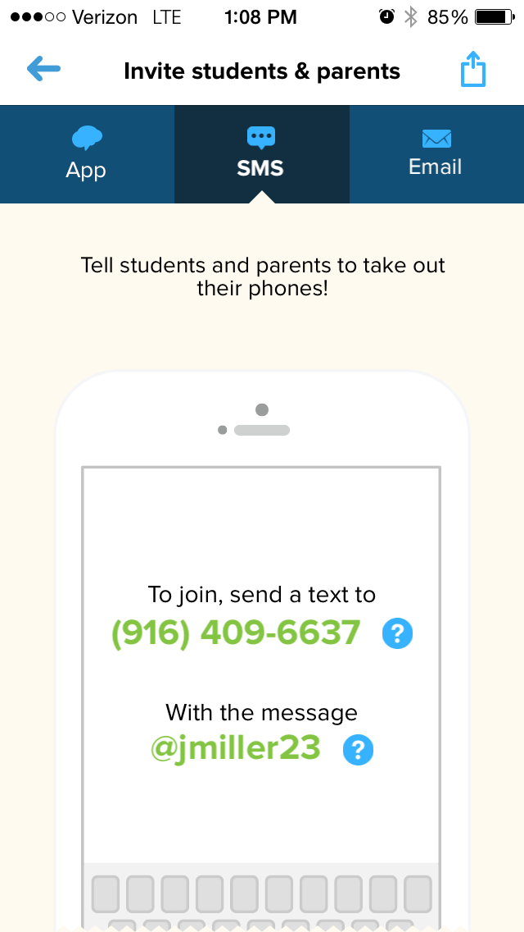
Remind 101

Slide 10
Missing Work Reports/Wednesday Folders
Grades are online this year on the class website. You should not be expecting missing work reports regularly.*
Missing work will typically be revealed by lower than typical grades online and a backpack full of work.
Most school paperwork will come home in Wednesday folders but more pertinent information will come home on a day to day basis.

Slide 11
Toys/Cell Phone
Toys - Don’t bring them.
If you think your child has a hard time focusing, please think about that fact before you buy them something for the classroom.
Cell Phones – If it rings, I will take it.
BYOD Contract* Personal Devices and Chromebooks

Slide 12
Birthdays
The class will sing a song but other than that, I won’t embarrass them.
If you want to bring in cupcakes or cookies, that is fine but please don’t expect a 30 minute celebration. We have 32 students and 1 hungry teacher.
Please remember that we have students that have nut allergies and some are vegetarians. If you can keep that in mind, we all would appreciate it.

Slide 13
Communication to Teacher (Jmiller@rocklin.k12.ca.us)
If you would like a prompt response, please email me.
If you would like me to not get back to you, please call me. The phone will ring sometimes and if it doesn’t, you’ll need to leave a message which I have no idea that you left.
You cannot respond back to me through Remind 101

Slide 14
Ways to help your student
Talk to them. Ask them about their day
Check their daily agenda and backpack even though it has been checked by a classmate
Give them a daily schedule for homework
Read with them
Help them with their work, but don’t do it

Slide 15
Ways to help Mr. Miller
Check their Daily Agenda
Come into the classroom every so often. Check their work. If it is messy, their understanding of the lesson might be messy too.
Communicate with me.
Be aware that some fieldtrips are not scheduled yet but we are working on it. Your assistance in funding those field trips is appreciated.*

Slide 16
Ways to help the Classroom
We need paper!!! Always
Expo Markers
Box Tops
Scholastic Book Orders
Join PTC*

